Slide 1
Hello world!

Slide 2
Outline
In this presentation, we will:
Describe programs
Define programming languages
Our first program: Hello world!
Integrated development environments and on-line compilers
The steps of compiling a program

Slide 3
What is a program?
To start, programs take data (numbers or text) and perform some operations on (or processes) that data
E.g., given two numbers, calculate the greatest common divisor
The result will be displayed on a screen

Slide 4

What is a program?
By next week, we will get data from a simple input device:
The keyboard

Slide 5
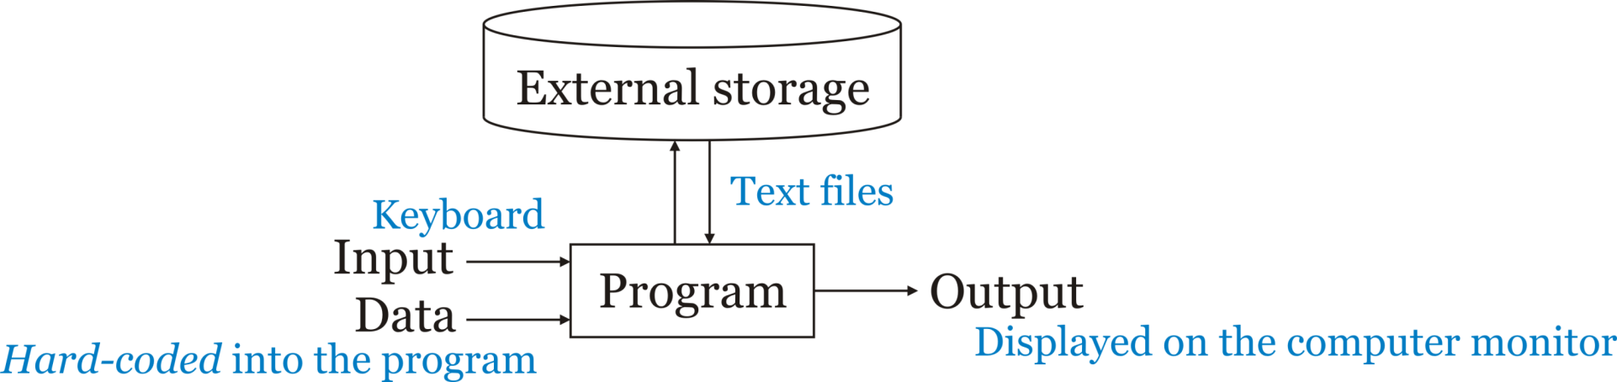
What is a program?
After the mid-term examination, we will access from and store data in files on the hard drive

Slide 6
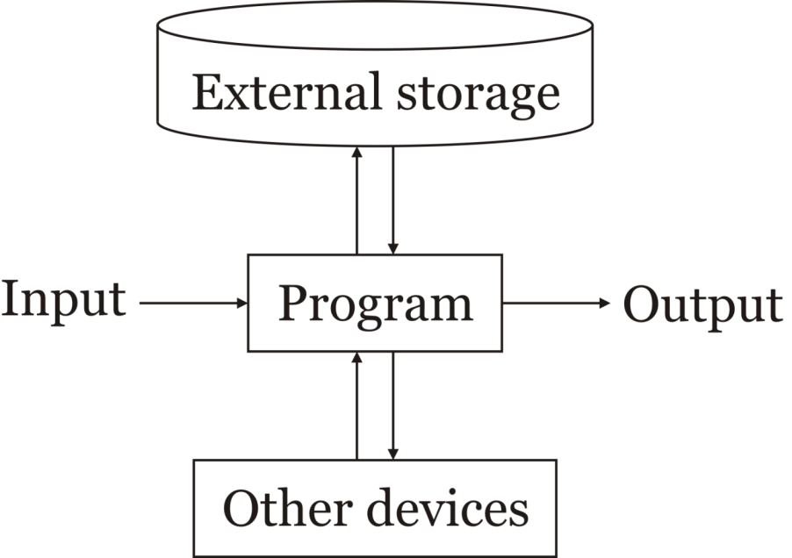
What is a program?
Hard-disk drives
Solid-state drives
Floppy drives
Optical drives
Tape drives
The Cloud
In general, a program:
Receives input
Communicates with other devices
Reads and stores data in external storage
Produces output
Note: these definitions are fluid
Printers and keyboards may communicate with the program
Any external storage is technically a device
Their dedication to long-term storage of data
Keyboards
Mouse
Microphone
Image scanner
Camera
Sensors
Monitors
Printers
Speakers
Actuators
Through:
- Expansion bus
- Internet
- Bluetooth
- CAN bus

Slide 7
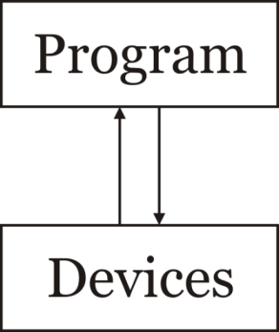
What is a program?
A simplified model:
A program communicates with devices to retrieve, process and store data
It’s still useful to consider the primary use of a device, be it for:
Input
Output
Storage
or a device to be communicated with

Slide 8
Why learn to program?
Why learn programming?
Programming is a systematic means of giving instructions to perform a task
If you are in electrical engineering, we have authored a web site to try to help you understand why the material in this course is relevant:
Why learn programming for electrical-engineering students?

Slide 9
Executing programs
When you execute/open/run an application, your computer, laptop or smart phone begins executing instructions
These instructions are coded using a binary encoding: 0s and 1s
The set of all possible instructions defines a machine language
These are difficult to read:
01100100 0011 0110 0101001000101010
01001110 0101 0011 0011100010001011
10001101 1010 0110 0000000000000000

Slide 10
Programming languages
A programming language is a human readable means of specifying the operations a computer is to perform
Programming languages are used to generate source code
This source code is compiled and translated into machine instructions
The resulting instructions can then be executed
Programming languages are restricted, however, to the characters that appear on a standard keyboard

Slide 11
Programming languages
A Programing Language (apl) attempted to introduce additional characters [4]:
D ← (u/A)^{[-1]}
x ← Db
y ← u\x
P ← DA
g ← c – (u/c)P
v ← ϵ ⌈ g
j ← (v/ι)₁
g_{j}:0
r ← x ÷ P_{j}
(r>0):0
This experiment failed…you will never have to learn apl ☺
Today, Matlab is used where apl used to be used

Slide 12
Programming languages
All of programming falls under the domain of mathematics
The Cheriton School of Computer Science is within the Faculty of Math
We cannot use mathematical notation in programming languages, and thus we must use other means of describing our intentions
Expression | Representation in C++
2(x + y) | 2*(x + y)
 | (n*n*n)/3
 | 0.5*9.8*s*s + v0*s
sin(x) | sin(x)
|x| | abs(x)
 | sqrt(x)

Slide 13
Our first program
#include <iostream>
int main();
int main() {
std::cout << "Hello world!";
std::cout << std::endl;
return 0;
}

Slide 14
Our first program
There are two approaches we can take to compiling and executing this code:
Using an Integrated Development Environment (ide)
We will use Eclipse in the laboratories
Using an on-line compiler such as https://repl.it/
On-line compilers, however:
May not always be available
Are useless for larger projects

Slide 15
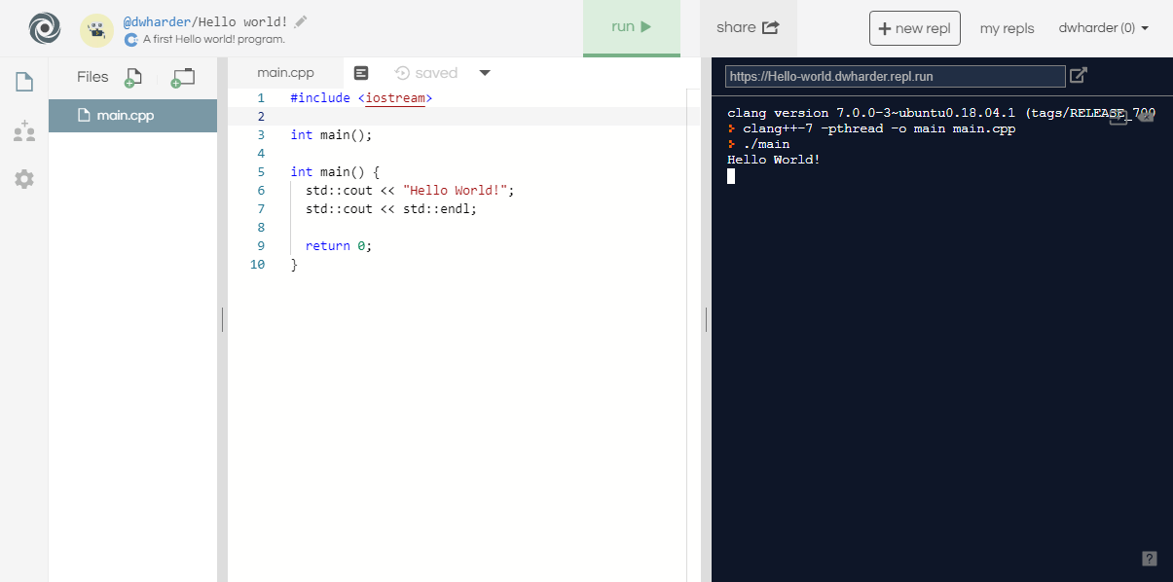
Our first program

Slide 16
Our first program
When you select the Run button, text is printed to the console output
Question: What is happening behind the scene?

Slide 17
Steps in generating an executable program
The program undergoes the following four steps in order to create an executable program that you can run
Step 1: Creating the program using a programming language, and writing it using an editor
Program Code

Slide 18
Steps in generating an executable program
The program undergoes the following four steps in order to create an executable program that you can run
Step 1: Creating the program using a programming language, and writing it using an editor
Step 2: Compiling the program into machine-language code
Program Code
Compiler

Slide 19
Steps in generating an executable program
The program undergoes the following four steps in order to create an executable program that you can run
Step 1: Creating the program using a programming language, and writing it using an editor
Step 2: Compiling the program into machine-language code
Step 3: Linking together the program with other helper programs into a single executable program
E.g., printing to the screen
Program Code
Compiler
Linker

Slide 20
Steps in generating an executable program
The program undergoes the following four steps in order to create an executable program that you can run
Step 1: Creating the program using a programming language, and writing it using an editor
Step 2: Compiling the program into machine-language code
Step 3: Linking together the program with other helper programs into a single executable program
E.g., printing to the screen
Step 4: Executing the program
Program Code
Compiler
Linker
Executable program

Slide 21
Summary
In this presentation, you now
Understand what a program is
Have an overview of how computers executing instructions
These are encoded in binary: 0s and 1s
Understand that programming languages allow us to define programs using a human-readable interface
The program must be compiled into an executable and run
Have written your first program: the ubiquitous Hello world!
Saw this output on https://repl.it
The first lab includes installing the Eclipse ide
You are not required to use Eclipse, but it is the only ide that is supported
Understand the steps of compilation

Slide 22
References
[1] https://en.wikipedia.org/wiki/APL_(programming_language)

Slide 23
Acknowledgments
Proof read by Dr. Thomas McConkey

Slide 24



Colophon
These slides were prepared using the Georgia typeface. Mathematical equations use Times New Roman, and source code is presented using Consolas.
The photographs of lilacs in bloom appearing on the title slide and accenting the top of each other slide were taken at the Royal Botanical Gardens on May 27, 2018 by Douglas Wilhelm Harder. Please see
https://www.rbg.ca/
for more information.

Slide 25
Disclaimer
These slides are provided for the ece 150 Fundamentals of Programming course taught at the University of Waterloo. The material in it reflects the authors’ best judgment in light of the information available to them at the time of preparation. Any reliance on these course slides by any party for any other purpose are the responsibility of such parties. The authors accept no responsibility for damages, if any, suffered by any party as a result of decisions made or actions based on these course slides for any other purpose than that for which it was intended.

